Slide 1
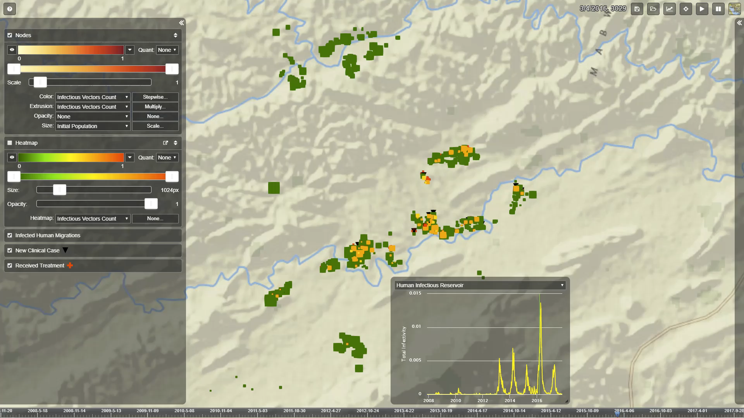
Vis-Tools http://idmod.org/docs/vis-tools/ https://github.com/InstituteforDiseaseModeling/Vis-Tools/
http://idmod.org/docs/vis-tools
Transport controls
Nodes layer controls
Bindings
Node info (when selected)
Heatmap layer controls
Other layers
Per-node inset charts (when selected)
Data summary graphs
Timeline
Notes:
Vis-tools is an incredibly flexible tool to visualize spatio-temporal model output.
It is also model-agnostic, so while we use it mostly to look at EMOD results, it can visualize any spatial output!
This is extremely useful for communicating model results or even to gain a better understanding of your results. You can use it to visualize your data!
Getting integrated into COMPS as the spatio-temporal data viewer; also functions as a stand-alone tool
video:
Can visualize any spatial data (doesn’t have to be EMOD output) & overlay timeseries information on it
Completely customizable, and Can select any of the output channels to view: customizable as to what you want color scales, 3-d structures (including size, shape, height), and other symbols to mean, so could use them to indicate starting pop, incidence, etc
Can overlay heatmaps (ex: vector populations)
Select nodes (each symbol) to look at inset charts for that node (and can select what data to see)
Can map & view migrations (zooming comets) of infected invidiuals, vectors, or other mobile entities
Can view the initiation of health interventions or other events (ex little black x’s or triangles) & see the spatial impact of the intervention
Can zoom, rotate, and select map type for background
Whatever you can think of to show off, you can probably do it with vis-tools!
[Combine in this info:
Visualization of spatio-temporal model output is important for the effective communication and thorough understanding of simulation results.
Vis-Tools is an innovative approach that allows on-the-fly binding of simulation inputs and outputs to visual elements. This creates an interactive display of model results with multiple layered and animated data channels.
This powerful, information-rich visualization tool can be used for any geospatial dataset and will:
Map migration of infected individuals, vectors, or other mobile entities
Overlay timeseries data
Use heatmaps, icons, 3-D structures, and color to represent virtually any data channel

